Slide 1

UNIVERSITI TEKNOLOGI MALAYSIA
Topic 2: Features of Software

Slide 2
Learning Outcome
By the end of Topic 2, learners should be able to:
Identify the variety of software applications across different business domains
Explain the basic roles of software engineer in modern era
Discuss the importance of sustainability, security, and intelligence features in modern software systems.
Analyze how different domains prioritize these features based on business goals and challenges.

Slide 3
Part 1: Introduction to SE Applications

Slide 4
Software Engineering Key Applications
Business & Finance: Streamlining operations (ERP, CRM) and financial services (Fintech).
Healthcare: Enhancing patient care (Telemedicine, Health Apps) and hospital management.
Education: Enabling online learning (LMS, E-learning) and expanding access to education.
Manufacturing: Driving automation (Industrial Software) and data-driven efficiency (IoT).
Government: Modernizing public services (E-government) and securing digital identities.
….

Slide 5
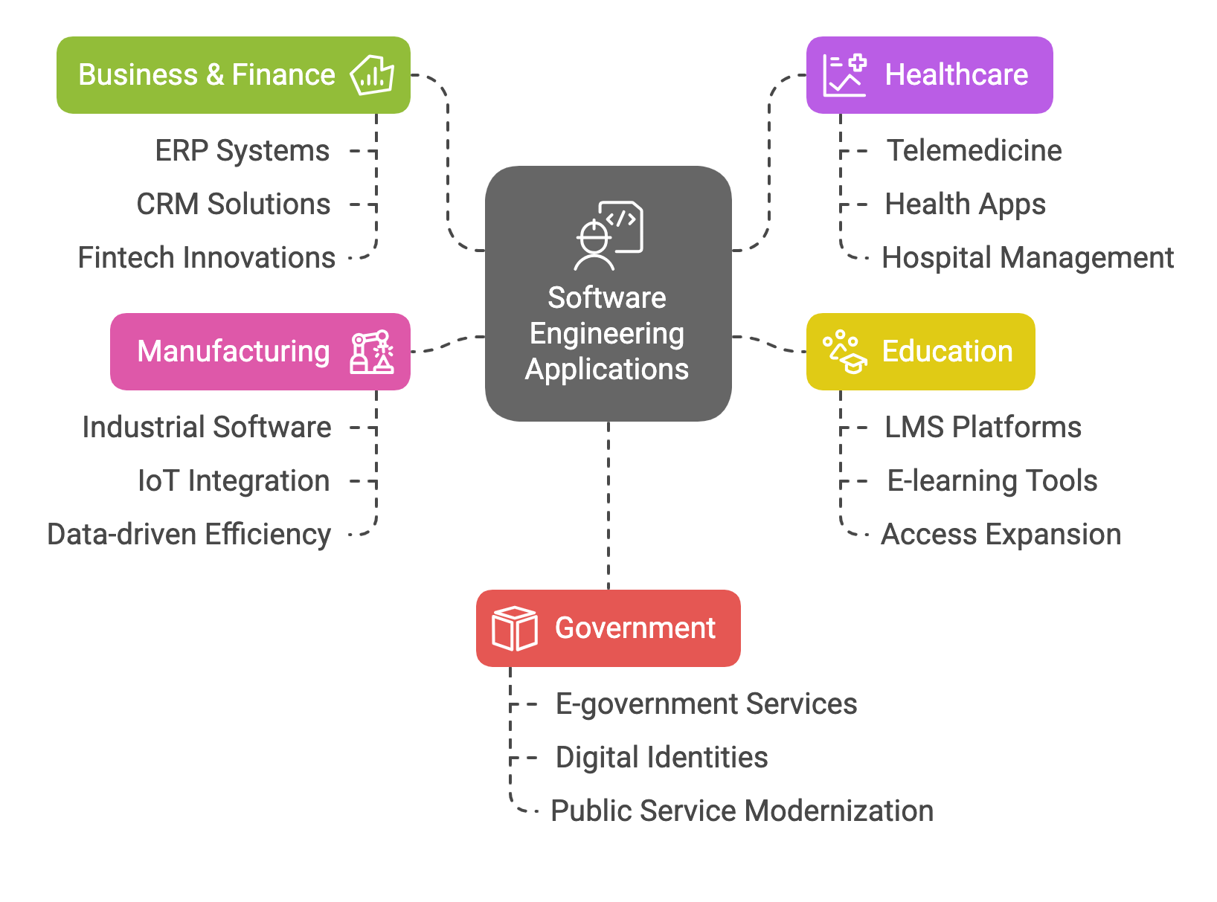

Slide 6
Basic Roles of Software Engineers
Software engineers design, build, and maintain software that supports modern life:
Understand needs: Work with stakeholders across various fields (like healthcare, finance, education) to create effective software solutions.
Apply core principles: Ensure software is secure, reliable, sustainable, easy to maintain, and adaptable.
Follow rules and ethics: Comply with regulations (e.g., HIPAA, GDPR), ensure accessibility, and promote responsible technology use.

Slide 7
Example of Software Engineer Various Roles
Software Architect: Designs the overall architecture of software systems, considering scalability, performance, security, and maintainability.
UX/UI Designer: Focuses on the user experience (UX) and user interface (UI) design of software applications, ensuring usability, accessibility, and visual appeal.
Full-Stack Developer: Possesses expertise in both front-end and back-end development, capable of building complete web applications from user interface to server-side logic.
DevOps Engineer: Bridges the gap between development and operations teams, automating software deployment, infrastructure management, and ensuring continuous integration and delivery.
AI/ML Engineer: Develops and deploys artificial intelligence and machine learning models to solve complex problems, automate tasks, and drive innovation.
Cloud Engineer: Designs, builds, and manages cloud infrastructure and applications, ensuring scalability, reliability, and security in a cloud-native environment.
Cybersecurity Engineer: Protects software systems and data from cyber threats, designs and implements security measures, and responds to security incidents.
Data Scientist/Engineer: Collects, analyzes, and interprets large datasets to extract meaningful insights, build data-driven models, and support decision-making.
IoT Engineer: Develops and deploys software for Internet of Things (IoT) devices, enabling connectivity, data collection, and automation in various industries.

Slide 8
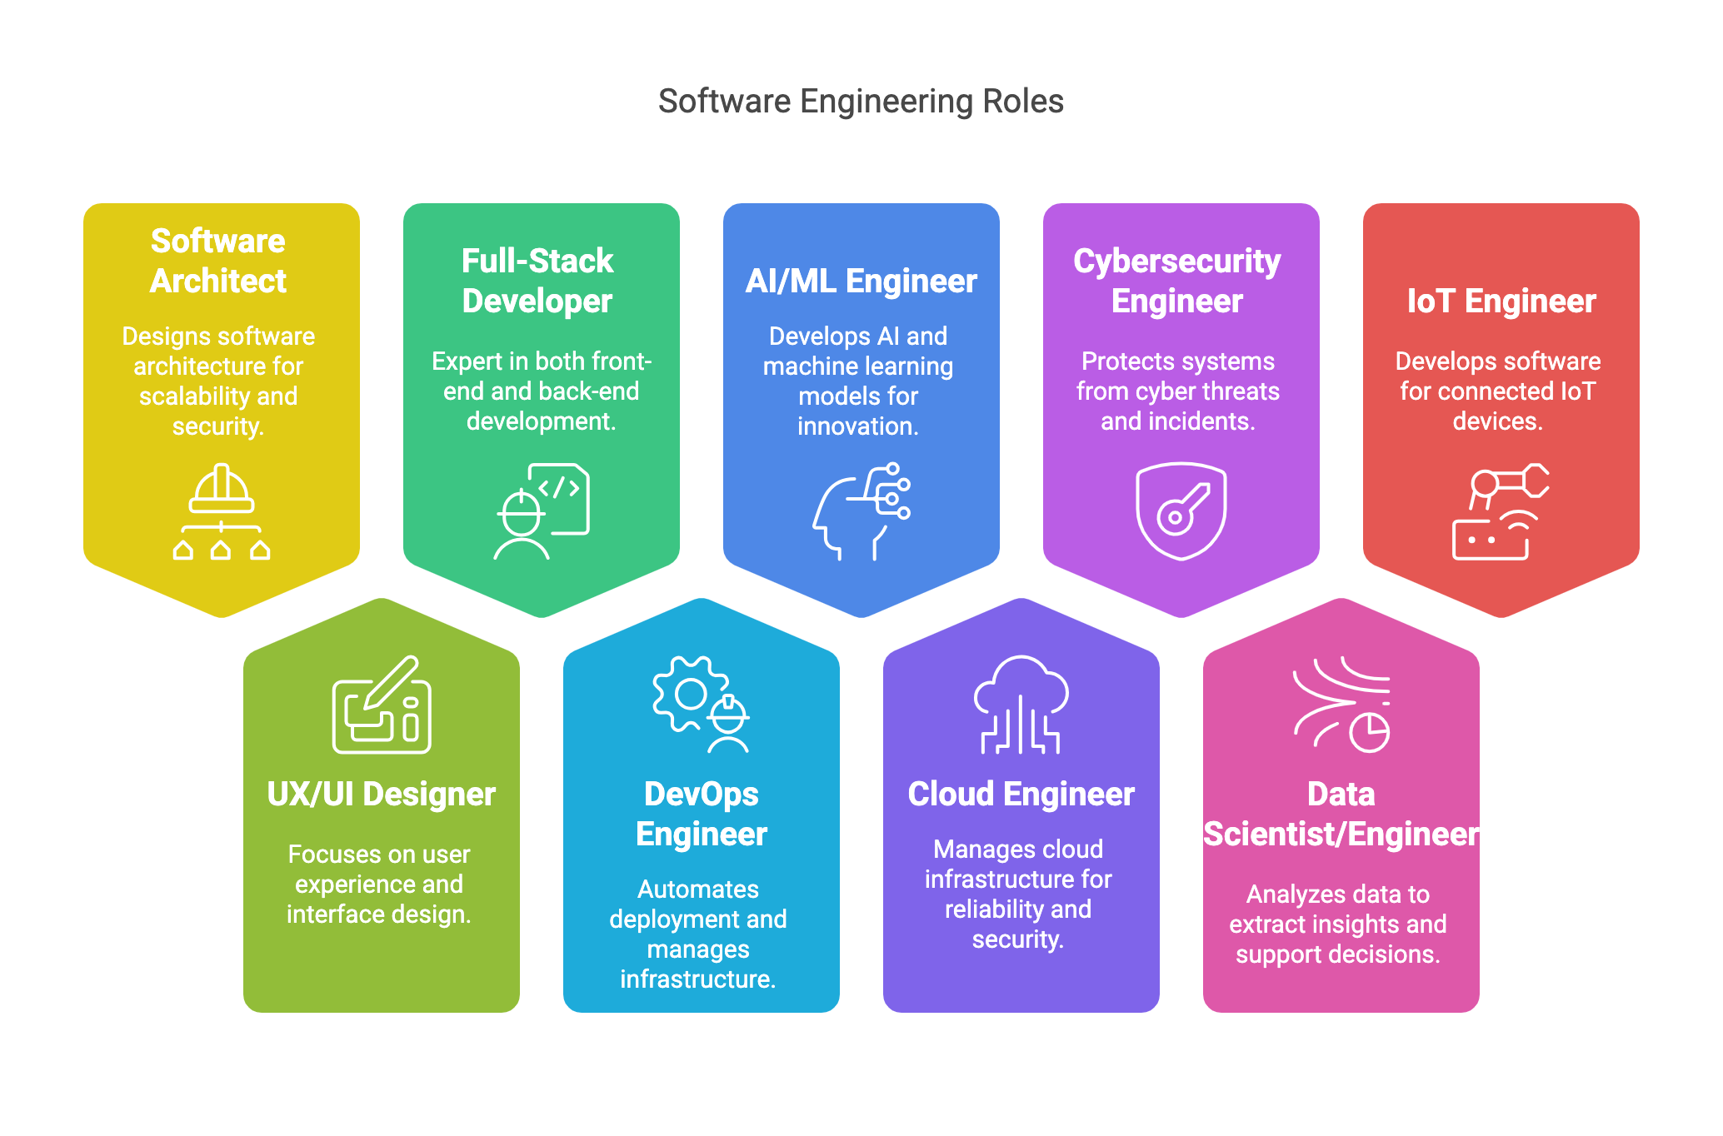

Slide 9
Important Features Across SE Applications
Feature | Description | Example
Sustainability | Focuses on energy-efficient coding, minimal resource use, and environmentally responsible development. | Green Data Centers, Efficient Algorithms
Security | Ensures confidentiality, integrity, and availability of software, particularly for sensitive data. | Encryption, Authentication Mechanisms
Intelligence | Incorporates AI/ML to enable data-driven decisions, automation, and predictive analytics. | Chatbots, Predictive Maintenance

Slide 10
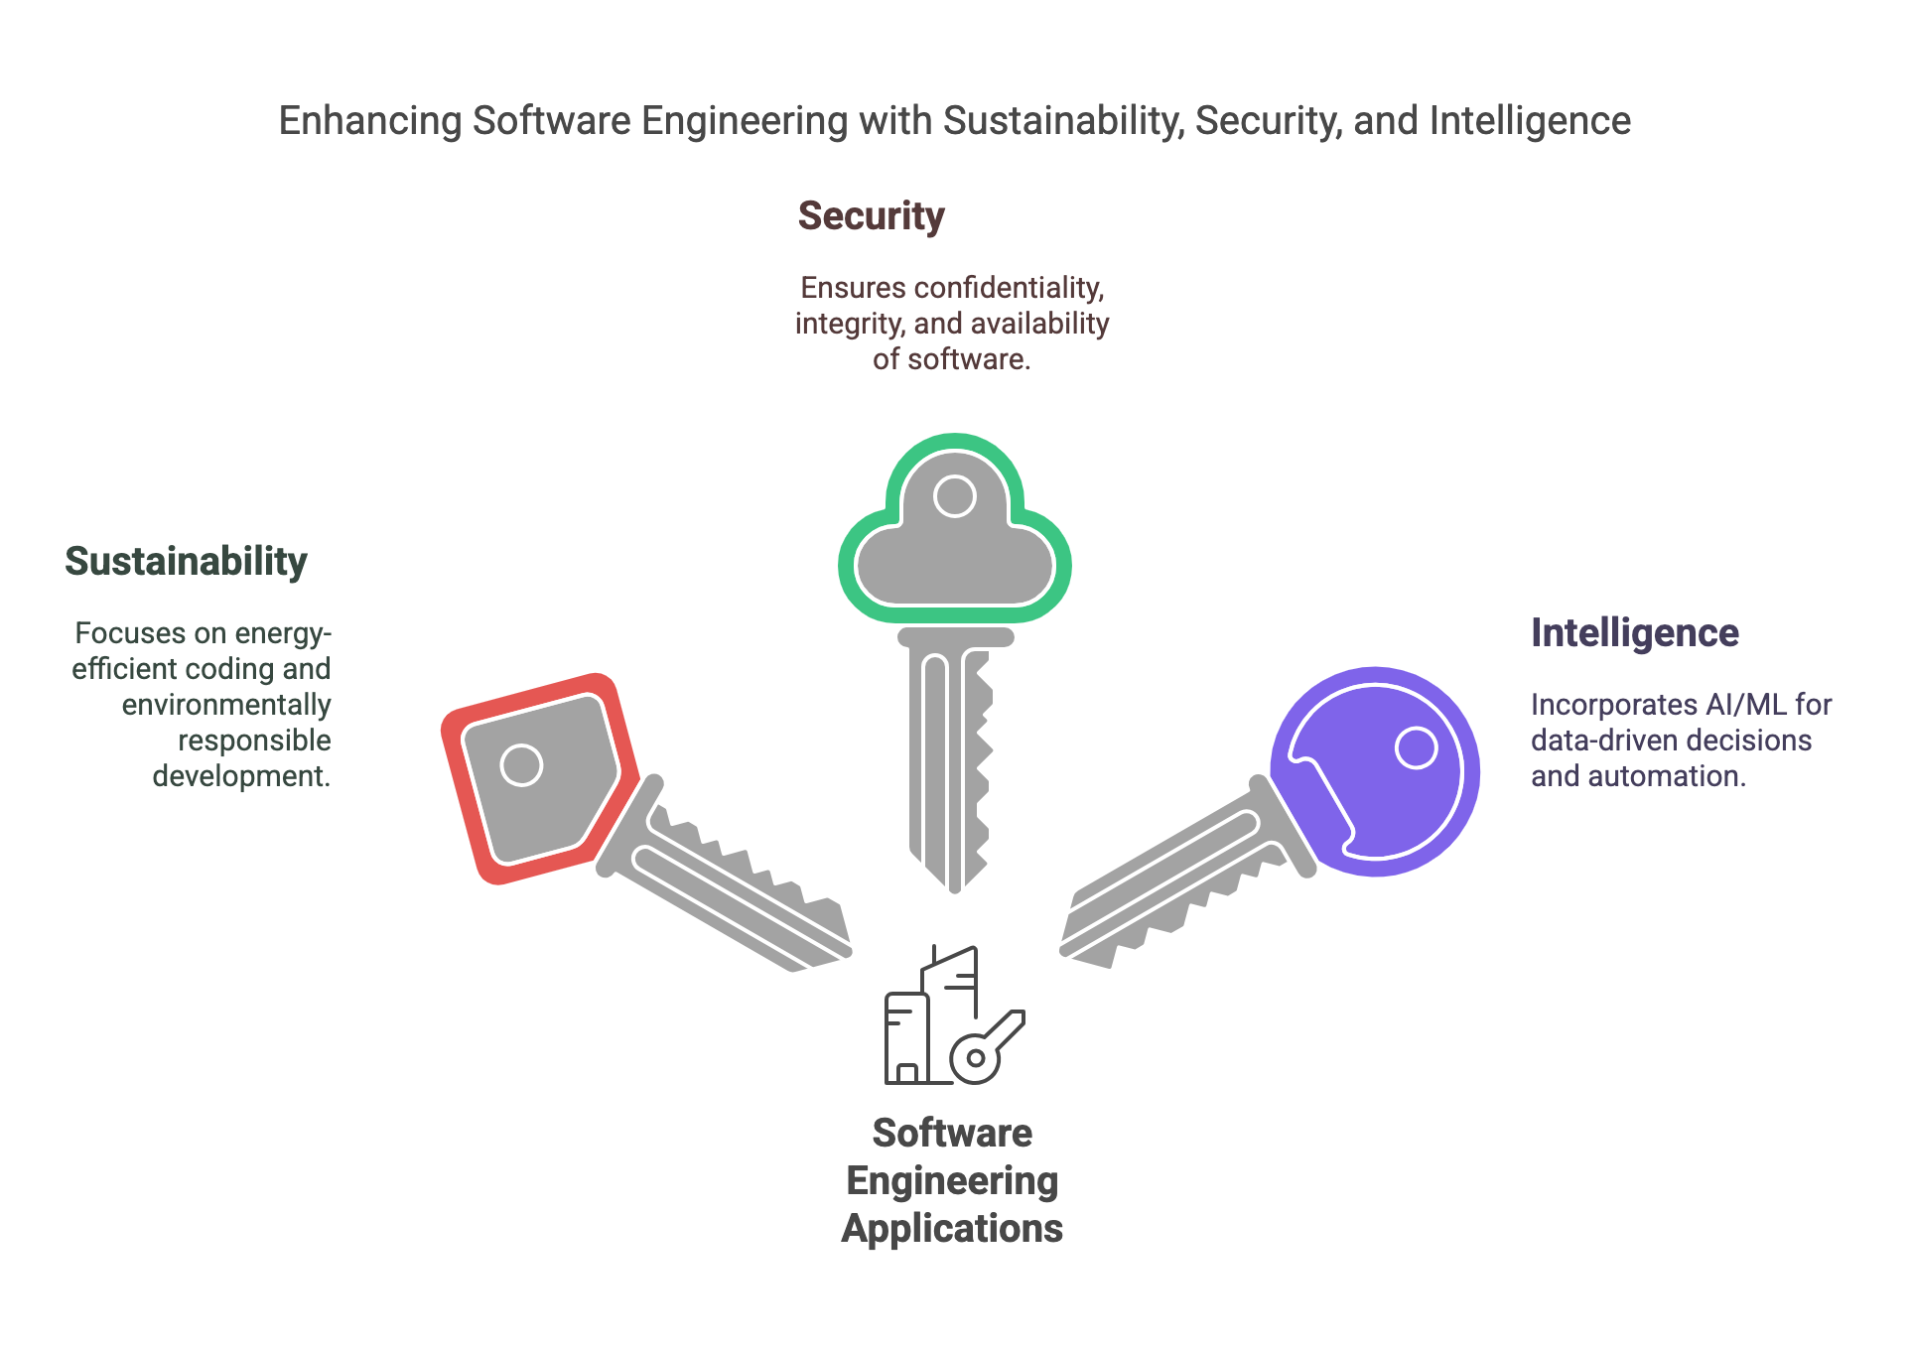

Slide 11
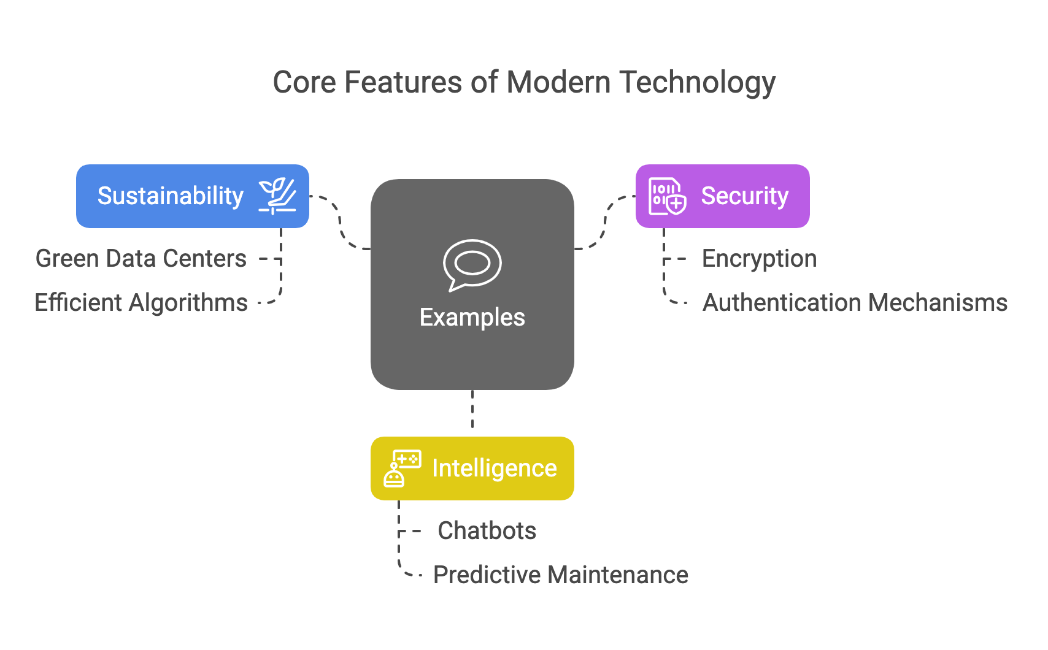

Slide 12
Part 2: Introduction to Sustainable Software Engineering
König, C., Lang, D. J., & Schaefer, I. (2024). Sustainable Software Engineering: Concepts, Challenges, and Vision. ACM Transactions on Software Engineering and Methodology. https://doi.org/10.1145/3709352

Slide 13
Overview of Sustainable Software Engineering
Definition: Developing and using software in a way that minimizes negative impacts on the environment, society, and economy, while maximizing the positive contributions software can make to sustainability in these areas. (König et al., 2024)
Crucial for addressing global challenges like climate change and social inequality.
It requires a holistic approach that considers the entire lifecycle of software, from development to end-of-life.

Slide 14
Sustainability in Software Focus Areas
Environmental sustainability:
  Reducing the carbon footprint of software
  Optimizing energy consumption of software
  Using resources efficiently in software development and deployment
Social sustainability:
  Ensuring equitable access to and benefits from software
  Promoting ethical considerations in software design and use
  Fostering transparency and inclusivity in software development
Economic sustainability:
  Creating sustainable business models for software
  Considering the long-term economic viability of software solutions
  Balancing economic growth with environmental and social well-being

Slide 15
Three Pillars of Sustainable SE
Sustainability Life Cycle Assessment (LCA)
  Evaluates all environmental, economic, and social impacts from software creation to disposal.
  Ensures software solutions are sustainable throughout their entire lifecycle.
Sustainability in Software Engineering
  Enhances software’s non-functional properties such as energy efficiency, usability, maintainability, and security.
  Optimizes performance to reduce resource consumption and increase long-term viability.
Software Engineering for Sustainability
  Targets software design and functionality that explicitly address sustainability challenges.
  Focuses on creating positive sustainability outcomes in domains such as agriculture, transportation, and healthcare.

Slide 16
Six principles of Sustainable SE (Microsoft)
The six principles that software engineers can use to make decisions that have a meaningful impact on the carbon pollution of their applications:
  Carbon Efficiency: Build applications that are carbon efficient.
  Electricity Efficiency: Build applications that are energy efficient.
  Carbon Awareness: Consume electricity with the lowest carbon intensity.
  Hardware Efficiency: Build applications that are hardware efficient.
  Measurement: Improve sustainability through measurement.
  Climate Commitments: Defining the exact mechanism of carbon reduction.
These six principles are independent of the following:
  Application domain
  Organization size or type
  Cloud vendor or self-hosted
  Programming language or framework
Reference: https://learn.microsoft.com/en-us/training/modules/sustainable-software-engineering-overview/

Slide 17
Principle 1: Carbon Efficiency
Definition: Minimize carbon emissions per unit of work in software applications.
Focus: Optimize software to perform tasks effectively while emitting the least possible carbon dioxide (CO₂).
Context: CO₂ is the most prevalent greenhouse gas resulting from human activities, contributing significantly to global warming.
Objective: Develop applications that deliver user value efficiently, reducing their environmental impact.
Reference: https://learn.microsoft.com/en-us/training/modules/sustainable-software-engineering-overview/3-carbon-efficiency
Notes:
https://learn.microsoft.com/en-us/training/modules/sustainable-software-engineering-overview/3-carbon-efficiency

Slide 18
Principle 2: Energy efficiency
Definition: Minimize the amount of energy consumed by software applications during their execution.
Focus: Optimize software to perform tasks effectively while using the least possible electrical energy.
Context: Electricity production, often reliant on fossil fuels, is a major source of carbon emissions.
Objective: Develop energy-efficient applications to reduce electricity consumption and associated carbon emissions.
By prioritizing energy efficiency in software development, we contribute to more sustainable computing practices and a healthier environment.
Reference: https://learn.microsoft.com/en-us/training/modules/sustainable-software-engineering-overview/4-energy-efficiency

Slide 19
Principle 3: Carbon awareness
Definition: Optimize software operations to align with periods when electricity is generated from cleaner, low-carbon sources.
Focus: Schedule computational tasks during times when the energy grid's carbon intensity is low, thereby reducing the carbon footprint of software applications.
Key Concepts:
  Carbon Intensity: The amount of CO₂ emissions produced per kilowatt-hour (kWh) of electricity consumed, measured in grams of CO₂ per kWh (gCO₂/kWh).
  Variability: Carbon intensity fluctuates based on location and time, influenced by factors such as the availability of renewable energy sources (e.g., solar, wind) and changes in electricity demand.
By incorporating carbon awareness into software design and operation, developers can significantly mitigate the environmental impact of their applications.
Reference: https://learn.microsoft.com/en-us/training/modules/sustainable-software-engineering-overview/5-carbon-awareness

Slide 20
Principle 4: Hardware efficiency
Definition: Optimize software to use the least amount of embodied carbon possible.
Focus: Extend hardware lifespan and increase resource utilization to reduce the carbon footprint associated with manufacturing and disposing of devices.
Key Concepts:
  Embodied Carbon: The total carbon emissions produced during the creation and disposal of a device.
  Amortizing Embodied Carbon: Distributing the carbon emissions over the expected lifespan of the hardware; extending hardware lifespan reduces annual carbon cost.
By prioritizing hardware efficiency in software development, we contribute to more sustainable computing practices and a healthier environment.
Reference : https://learn.microsoft.com/en-us/training/modules/sustainable-software-engineering-overview/6-hardware-efficiency

Slide 21
Principle 5: Measurement
Definition: Implement quantifiable metrics to assess and manage the carbon emissions associated with software applications.
Key Frameworks:
  Greenhouse Gas (GHG) Protocol: A standardized method for organizations to calculate total emissions
  Software Carbon Intensity (SCI) Specification: A methodology to measure carbon emissions specific to software applications, providing a consistent framework to evaluate and improve software sustainability.
By adopting the principle of measurement, organizations can effectively monitor and reduce the carbon footprint of their software solutions.
Reference : https://learn.microsoft.com/en-us/training/modules/sustainable-software-engineering-overview/7-measurement

Slide 22
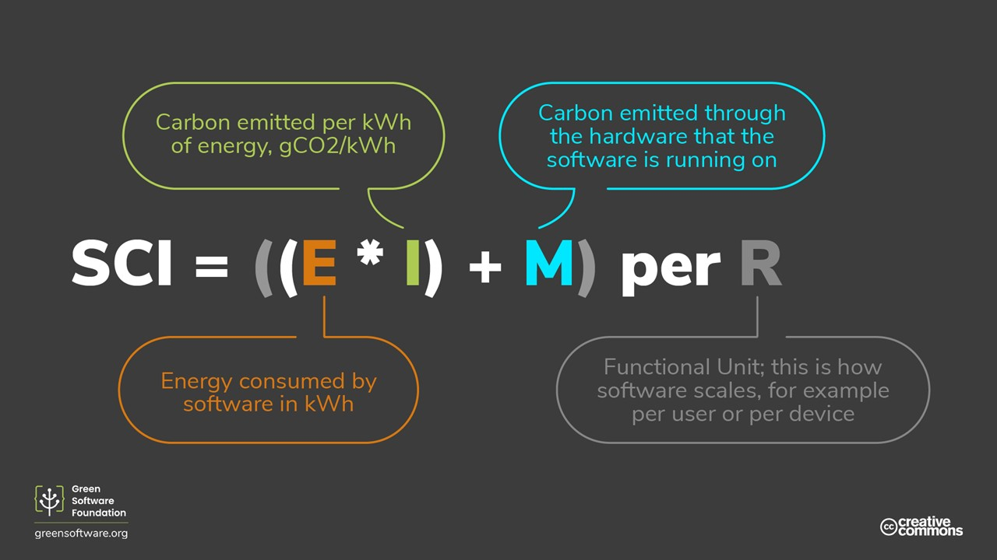
Principle 5: Measurement - Software Carbon Intensity (SCI)

Slide 23
Principle 6: Climate commitments
Definition: Implement strategies to reduce carbon emissions, aligning with global climate goals.
Key Strategies:
  Abatement (Carbon Elimination): Focus on not emitting carbon in the first place.
  Offsetting: Compensate for emissions by reducing carbon elsewhere.
    Compensation (Avoidance): Pay others not to emit carbon.
    Neutralization (Removal): Remove carbon from the atmosphere through methods like forest restoration or direct air capture.
Climate Commitment Strategies:
  Carbon Neutral: Measure and match emissions through reduction projects, including removal and avoidance.
    Requires covering all Scope 1 and 2 emissions, and significant Scope 3 emissions.
  Net Zero: Reduce emissions in line with a 1.5°C pathway, balancing residual emissions through carbon removals.
    Aims to eliminate 90% of emissions, permanently neutralizing the remaining 10%.
    Encompasses direct and indirect emissions from Scopes 1, 2, and 3.
Understanding these principles is vital for organizations to effectively plan and execute their sustainability initiatives.
Reference : https://learn.microsoft.com/en-us/training/modules/sustainable-software-engineering-overview/8-climate-commitments

Slide 24
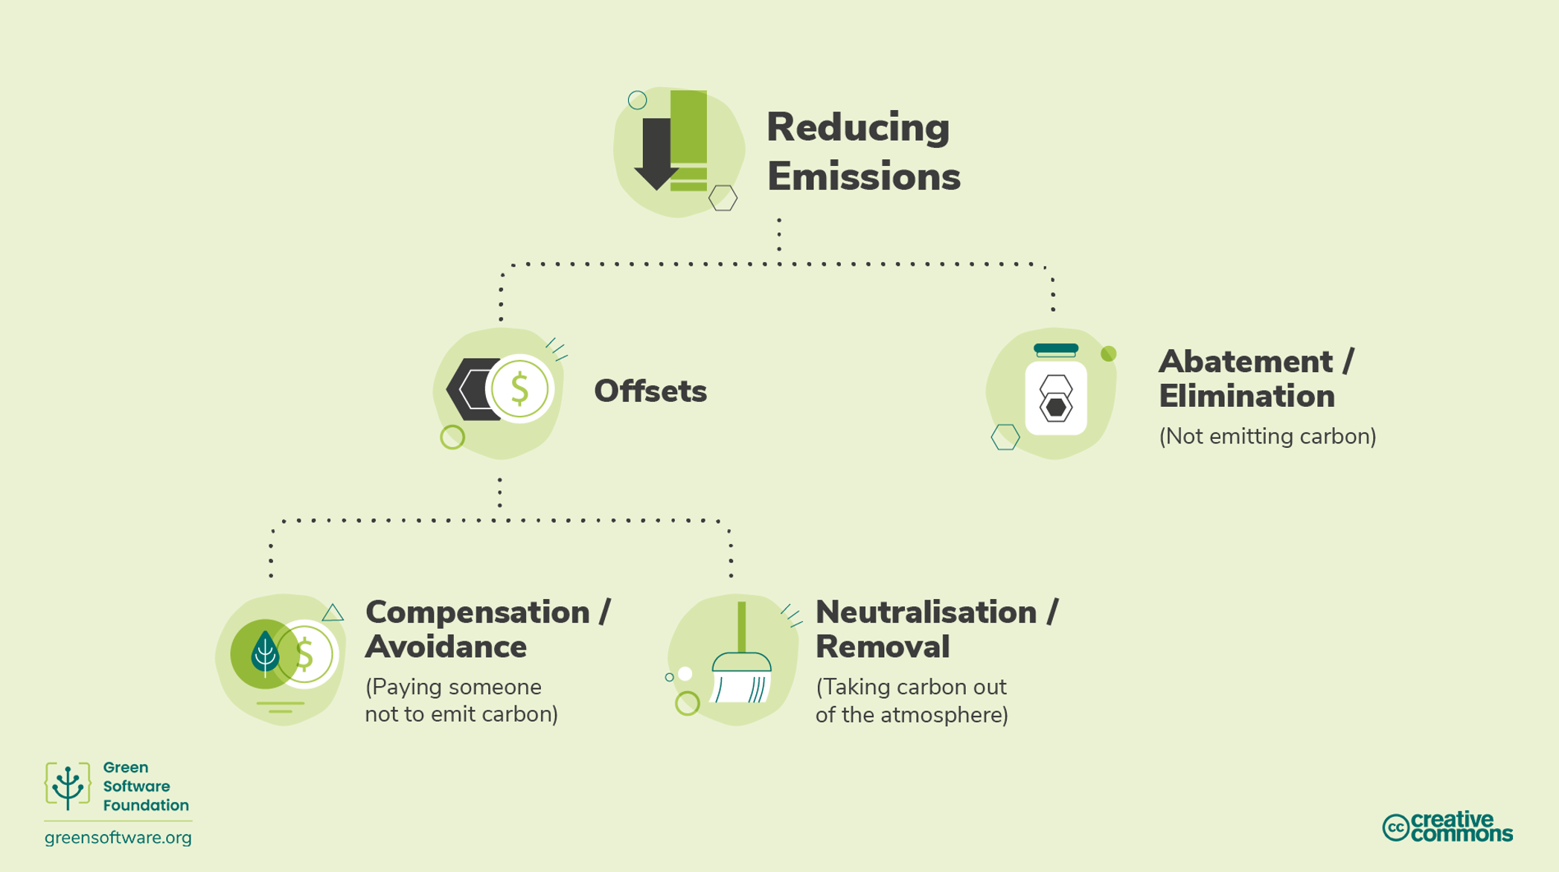
Principle 6: Climate commitments

Slide 25
Part 3: Security in Software Application
Basic concepts from CSSLP certificate and exam

Slide 26
01: Security Core Concepts in Software
Confidentiality (e.g., encryption)
Integrity (e.g., hashing, digital signatures, code signing, reliability, modifications, authenticity)
Availability (e.g., redundancy, replication, clustering, scalability, resiliency)
Authentication (e.g., multi-factor authentication (MFA), identity & access management (IAM),
Single Sign-On (SSO), federated identity, biometrics)
Authorization (e.g., access controls, permissions, entitlements)
Accountability (e.g., auditing, logging)
Nonrepudiation (e.g., digital signatures, block chain)
Governance, risk and compliance (GRC) standards (e.g., regulatory authority, legal, industry)

Slide 27

The Three Rs of Security Software
Reliability
software should function as expected
01
Resiliency
software should withstand misuse and attack
03
02
Recoverability
having the ability for normal business operations restoration with minimal disruption.

Slide 28



The CIA Triad of Security Software
CONFIDENTIALITY
Preventing unauthorized disclosure of information through encryption and access controls.
The opposite of
Disclosure-Alteration-Destruction (DAD)
INTEGRITY
Ensuring the accuracy and completeness of data by preventing unauthorized modifications, leveraging hashing and code signing.
AVAILABILITY
Guaranteeing reliable and timely access to information and resources through redundancy, failover, and fault tolerance measures.

Slide 29
Confidentiality
Preserving authorized restrictions on information access and disclosure, including means for protecting personal privacy and proprietary information
Reference: NIST’s FIPS 199—Standards for Security Categorization of Federal Information and Information Systems
Definition
Sensitive data and information must be protected at all times whether in transit across a network, at rest on storage media, or while being leveraged by an application.
Goal
Encryption and Access Control
Security Control

Slide 30
Confidentiality : Encryption
Encryption is the process of converting or scrambling data and information into an unreadable, encoded version that can only be read with authorized access.
Encryption is a widely used security tool that can prevent the interception of sensitive data, either while stored in files or while in transit across networks.
Encryption of data in transit and technologies that might be used for this purpose (e.g., TLS 1.3) - Transport Layer Security (TLS) is in common use.
Encryption of data at rest, in the database using Advanced Encryption Standard (AES) 256 through Transparent Data Encryption (TDE).
Any network service that handles sensitive or valuable data, whether it is personally identifiable information (PII), financial data, or login information, needs to adequately protect that data.

Slide 31
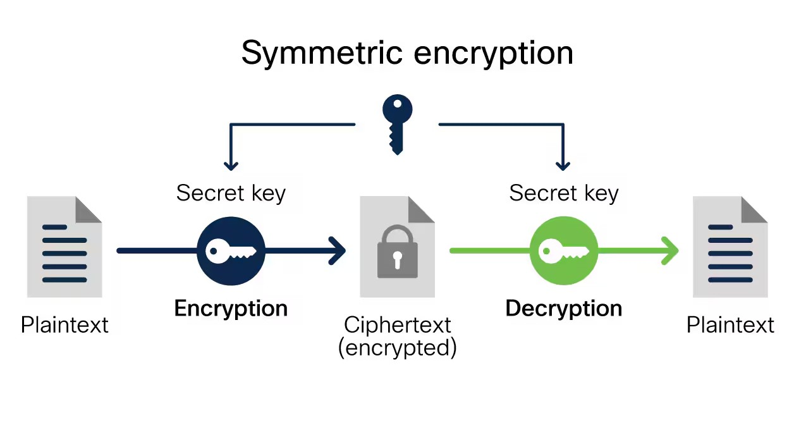
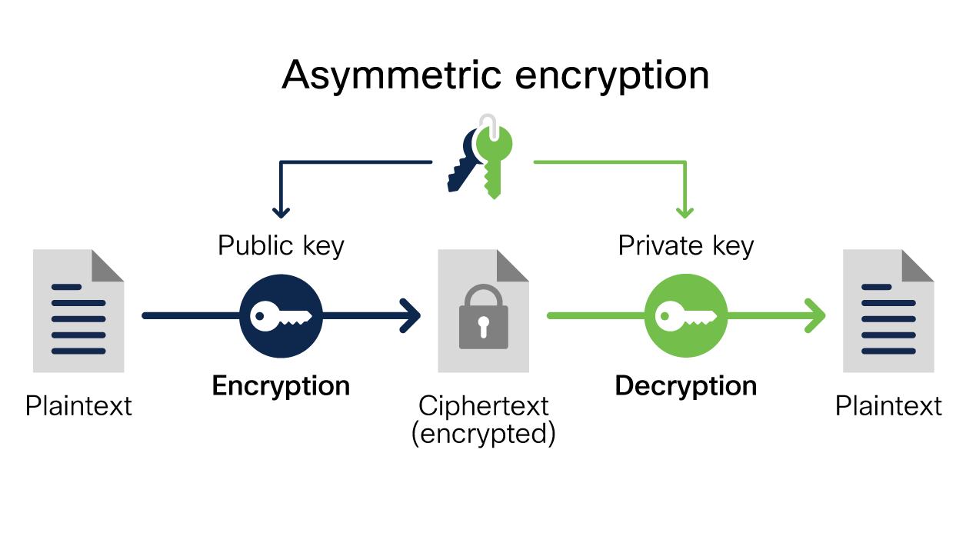
Confidentiality : Encryption
Source: https://www.cisco.com/c/en/us/products/security/encryption-explained.html#~types-of-data-encryption

Slide 32
Integrity
A property whereby data has not been altered in an unauthorized manner since it was created, transmitted, or stored
Reference: NIST - National Institute of Standards and Technology;
Definition
Modifications are not made to data by unauthorized subjects
(personnel or processes).
Unauthorized modifications are not made to data by authorized
subjects.
The data is internally and externally consistent.
Goal
Hashing, Digital Signature and Code Signing
Security Control

Slide 33
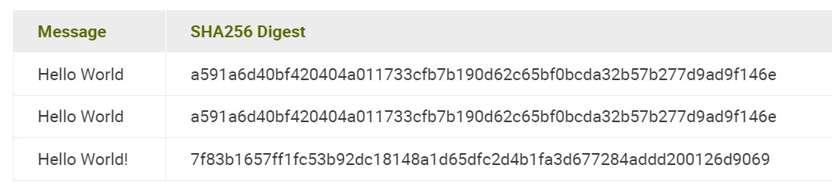
Integrity: Hashing
Hashing works by using cryptographic hash functions to create a fixed-size digest from variable length message (input).

Slide 34
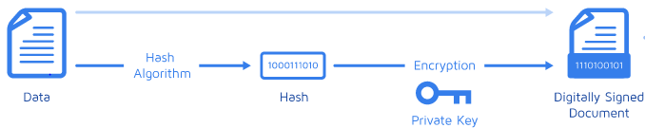
Integrity: Digital Signature
Digital Signature - a type of electronic signature—is a mathematical algorithm that validates the authenticity and integrity of emails, credit card transactions, and digital documents through a unique virtual fingerprint that identifies users and protects information.
Code Signing
Application of a digital signature to the code is a common mechanism of protecting software primarily during the distribution and maintenance phases.

Slide 35
Availability
Reliable and timely access to the data and computing resources must be ensured.
Definition
Reliable access to information for intended entities
Availability of the correct resources within the correct amount of time for the correct subjects
Goal
Redundancy, Fail over, Fault tolerance, RAID, High availability clusters, Replication
Security Control

Slide 36
Security Control for Availability
Redundancy. Mainly continuing the running of an organization even with the absence/failure of one important component. Redundancy in DBMS means copying data within a database or using a separate data storage technology in two separate places.
Failover. Switching to a redundant or standby computer server, system, hardware component, or network upon the failure or abnormal termination of the previously active application, server, system, hardware component, or network.
Fault tolerance. The system remains working as expected even when some of its components are failing.
RAID. A redundant array of independent disks (RAID) is a data storage virtualization technology that combines multiple physical disk-drive components into a single logical unit for the purposes of data redundancy, performance improvement, or both.
High-availability clusters (failover clusters). These are groups of computers that support server applications that can be reliably utilized with a minimum of downtime. They operate by using high- availability software to harness redundant computers in groups or clusters that provide continued service when system components fail.
Replication. This is the process of storing data in more than one site or node. As an example, directory services replication is often used to prevent the loss of a single server which would otherwise cause the directory service to become unavailable.

Slide 37
Access Control
Confidentiality supports the principle of “least privilege” by allowing access only to authorized individuals, processes, or systems, and only on a need-to-know basis.
Access controls support confidentiality and integrity.
Access control is based on identification, authentication, authorization, and accountability—IAAA.
Identification: I am Azizah.
Authentication: Prove I am Azizah.
Authorization: Azizah is allowed to do XYZ.
Accountability: Azizah’s actions are logged and non-repudiation.

Slide 38

Access Control to Protect Confidentiality
Biometrics
Steganography
Non-technical safeguards
  Additional security awareness and training
  Minimizing retention of sensitive information
  Limiting physical access to infrastructure
  Establishing policies and procedures

Slide 39
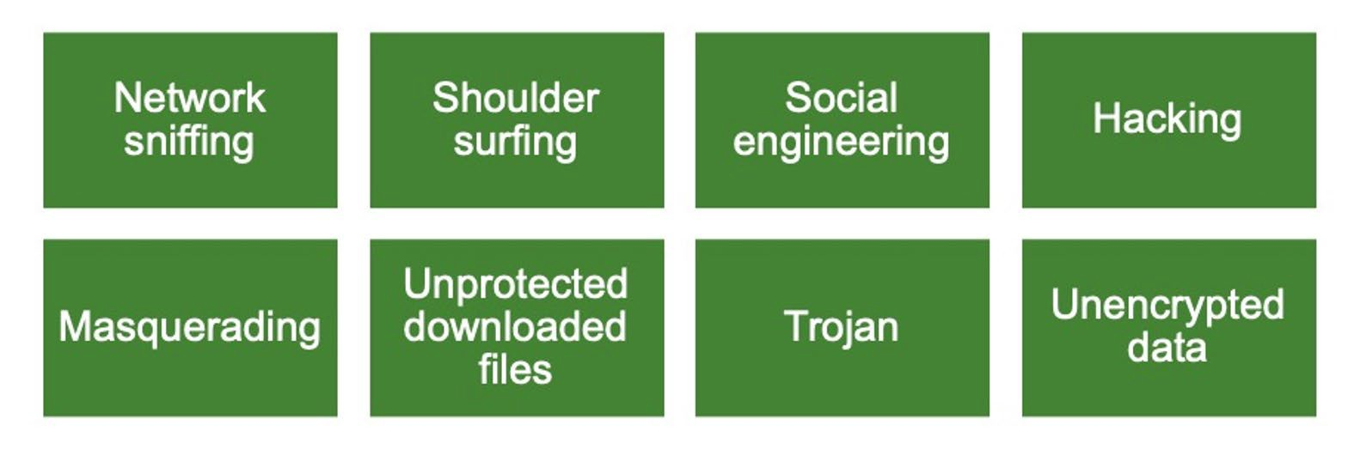
Compromising Confidentiality

Slide 40
Elements of Security Design
Accountability
Auditing Logging
Security Information and Event Management (SIEM) Non-repudiation

Slide 41
Elements of Security Design: Blockchain Example
Protection against unauthorized changes
Redundancy and elimination of single point of failure
Transparency

Slide 42
Elements of Security Design: Governance, Risk, and Compliance (GRC)
Governance
Compliance
Establishing policies, procedures, and controls to align software security with business objectives and goals.
Ensuring that the software adheres to relevant laws, regulations, and industry standards to avoid legal and and regulatory issues.
Risk Management
Identifying, analyzing, and mitigating risks to an acceptable level through security design and implementation.

Slide 43
02: Security Design Principles
Least privilege (e.g., access control, need-to-know, run-time privileges, Zero Trust)
Segregation of Duties (SoD) (e.g., multi-party control, secret sharing, split knowledge)
Defense in depth (e.g., layered controls, geographical diversity, technical diversity, distributed systems)
Resiliency (e.g., fail safe, fail secure, no single point of failure, failover)
Economy of mechanism (e.g., single sign-on (SSO), password vaults, resource efficiency)
Complete mediation (e.g., cookie management, session management, caching of credentials)
Least common mechanism (e.g., compartmentalization/isolation, allow/accept list)
Psychological acceptability (e.g., password complexity, passwordless authentication, screen layouts,
Completely Automated Public Turing test to tell Computers and Humans Apart (CAPTCHA))
Component reuse (e.g., common controls, libraries)

Slide 44
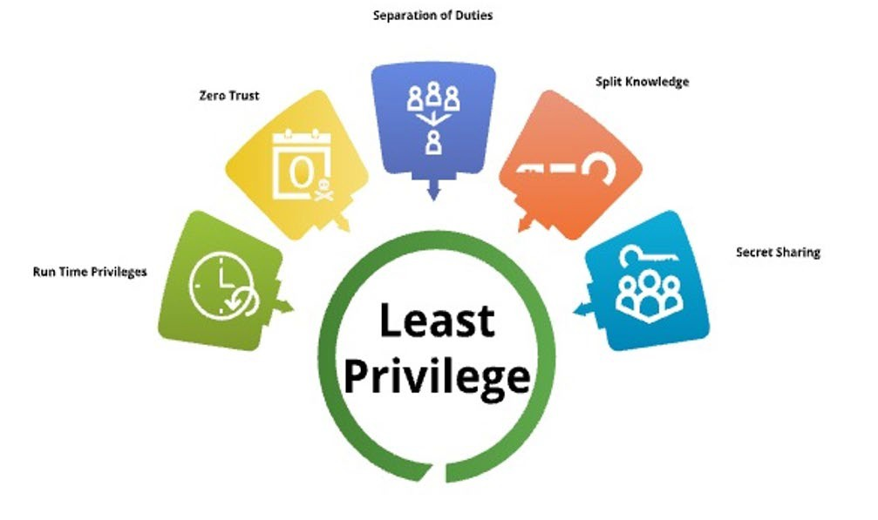
Least Privilege

Slide 45
Defense-in-Depth
Layered Control
Input Validation Security Zones Diversity of Defence Resiliency
Economy of Mechanism Password Vault

Slide 46
Defense-in-Depth (Cont..)
Resource Efficiency
Complete Mediation Open Design
Modular Open Systems Approach (MOSA) Resiliency
Open Source Software Collaborative Design

Slide 47
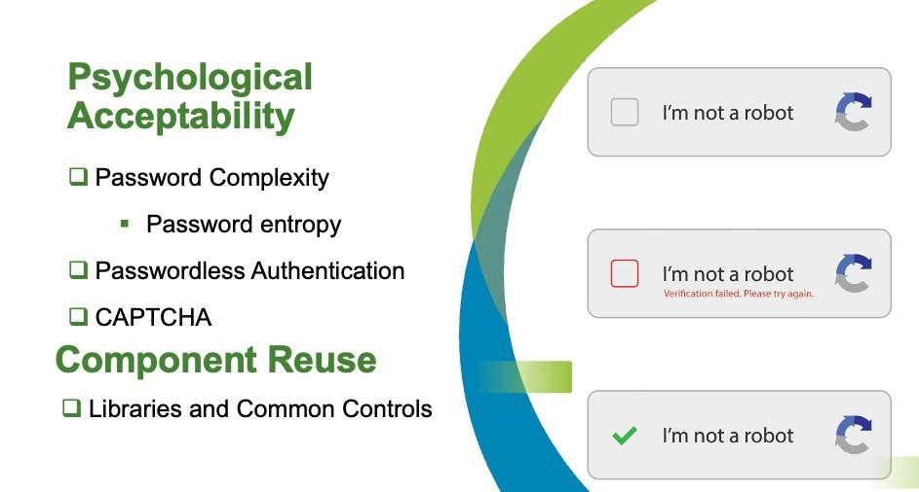

Slide 48
Conclusion: Software Security
Core Security Objectives:
  Understand confidentiality, integrity, and availability (CIA) in software security.
  Privacy considerations are also critical in security planning.
Secure Software Concepts:
  Focus on architectural decisions that are independent of platform or programming language.
  Establish principles and abstractions to build secure software foundations.
Consistent Security Process:
  Ensure secure system and software design is consistent, repeatable, measurable, and monitored across the life cycle.
Integration of Business and Security Goals:
  Incorporate security from the beginning of the system engineering life cycle.
  Governance, Risk, and Compliance (GRC) should integrate business, risk, and compliance into a manageable process.

Slide 49
Part 4: Intelligence in Software Application

Slide 50

What is intelligence?
the ability to comprehend, to understand and profit from experience?
For thousands of years people tried to understand how we think
Philosophy
Mathematics
    What is correct mathematical reasoning?
Neuroscience
Psychology
Economics

Slide 51
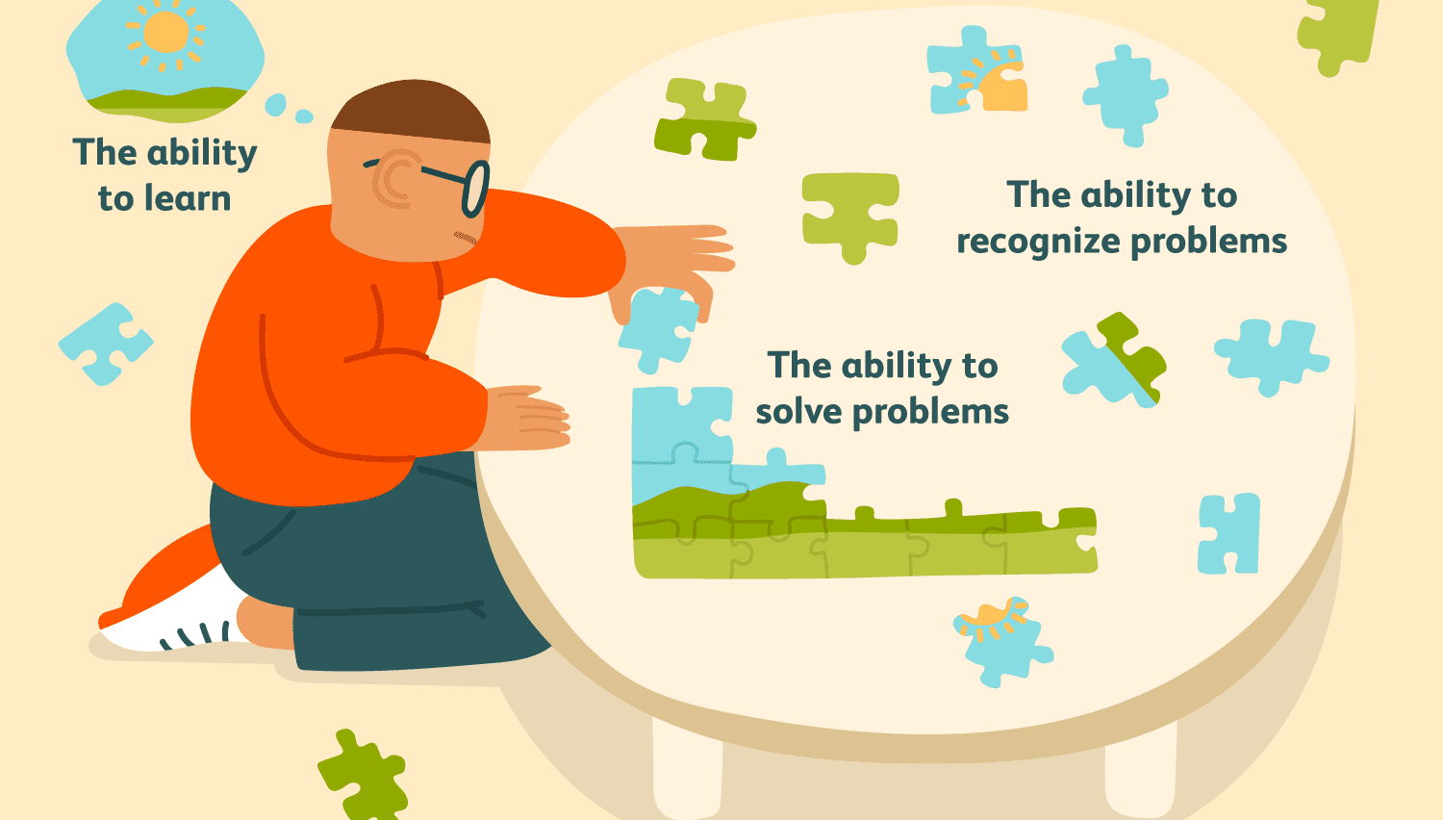
Intelligence
intelligence

Slide 52
Definition: Intelligent software
Software that has a good understanding of a multitude of areas and is able to apply this understanding to solving problems; to figure things out, calculate, predict, manage, and analyze.
Able to learn and apply the material of any subject and at any level of complexity.
It should transfer to the computer the ability to increasingly do the tasks that we now do as humans.
Reference: Feigenbaum, T. D. (2016). Building intelligent information systems software. Morgan Kaufmann.

Slide 53
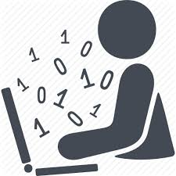
What is AI? : From the book…
Artificial Intelligence is composed of two words Artificial and Intelligence, where Artificial defines "man-made," and intelligence defines "thinking power", hence AI means "a man-made thinking power."
"It is a branch of computer science by which we can create intelligent machines which can behave like a human, think like humans, and able to make decisions."
Artificial Intelligence exists when a machine can have human based skills such as learning, reasoning, and solving problems.
Notes:
Modeling human cognition using computers
The study of problems that other CS folks do not yet know how to do
Cool stuff!!!
Game playing agents, machine learning, data mining, speech, language, vision, web agents, chatbots, robots, ...
Useful stuff!!!
Medical diagnosis, fraud detection, genome analysis, object identification, space shuttle scheduling, information retrieval, ...

Slide 54
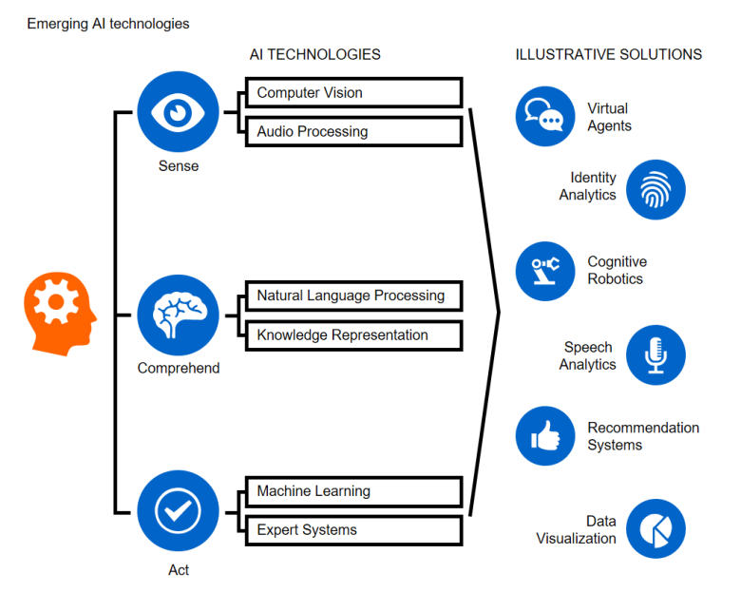
Area of AI?

Slide 55
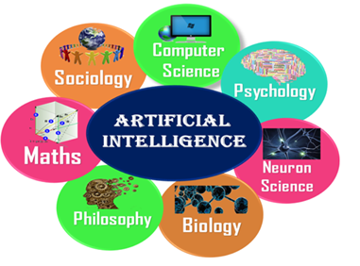
What comprises to Artificial Intelligence?
Artificial Intelligence is not just a part of computer science even it's so vast and requires lots of other factors which can contribute to it. To create the AI first we should know that how intelligence is composed, so the Intelligence is an intangible part of our brain which is a combination of Reasoning, learning, problem-solving perception, language understanding, etc.
To achieve the above factors for a machine or software Artificial Intelligence requires the following discipline:
Mathematics
Biology
Psychology
Sociology
Computer Science
Neurons Study
Statistics

Slide 56
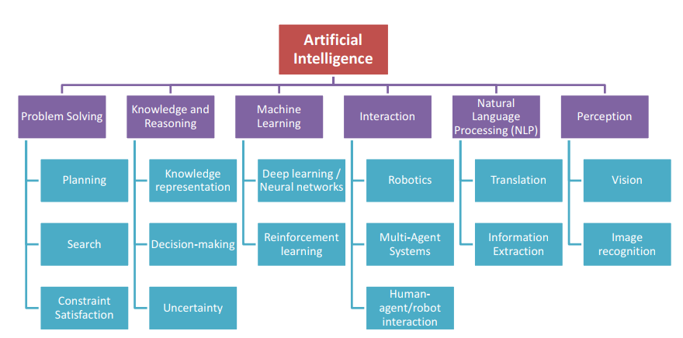
Main Current Stream in AI
Dignum, V. (2019)

Slide 57
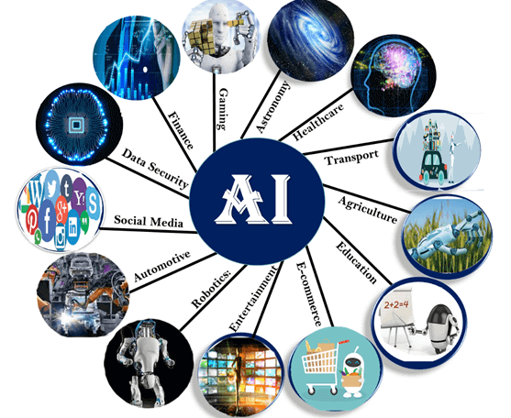
Applications of AI in Various Sectors
Notes:
https://www.javatpoint.com/application-of-ai
https://searchenterpriseai.techtarget.com/definition/AI-Artificial-Intelligence

Slide 58
Conclusion: Intelligent software
Software leveraging Artificial Intelligence (AI) and machine learning
Ability to learn, adapt, and make decisions
Data-driven and context-aware applications
Notes:
AI-Powered Film
https://youtu.be/wHiEDVC2kEQ?si=GxPwqP4CDsZ9-IhH
Agentic AI
https://youtu.be/0z9_MhcYvcY?si=755pE-y2SH0pniFA
What are AI Agents
https://youtu.be/F8NKVhkZZWI?si=voagc_BPxF5UfmOe
Reinforcement Learning
https://www.youtube.com/watch?v=JgvyzIkgxF0

Slide 59
Summary
Key Learning Outcome
Explore software applications across business domains, including healthcare, finance, education, government and manufacturing
Discuss the roles of software engineers, such as architects, UX/UI designers, full-stack developers, and DevOps engineers, and their focus on creating secure, reliable, sustainable, and adaptable software in collaboration with stakeholders.
Examine the importance of sustainability in software engineering, covering environmental, social, and economic aspects, such as reducing carbon footprints, optimizing energy use, ensuring equity, and promoting ethical, long-term business models.
Review key security features from the CIA Triad: confidentiality (encryption, access control), integrity (hashing, digital signatures), and availability (redundancy, failover), highlighting their role in secure data management and system reliability.
Explore the role of AI and machine learning in creating intelligent software, enabling it to learn, adapt, and make decisions, and examined AI applications across sectors to enhance functionality.

